Slide 1
Batch No – 32
Spaceship Titanic
Faculty Coordinator – Mrs. Subha Meenakshi
Team Members :-
Vivek Pandith D V - 1BI20AI056
Yashwanth Gowda - 1BI20AI059

Slide 2

Abstract
In the aftermath of a catastrophic spacetime anomaly encountered by the Spaceship Titanic—an interstellar passenger liner enroute to new habitable exoplanets—nearly half of its 13,000 passengers inexplicably vanished into an alternate dimension. This abstract presents a machine learning approach aimed at identifying and predicting which passengers were transported by the anomaly. Leveraging recovered data from the vessel's damaged computer system, this predictive analysis navigates through the records of the ill-fated journey to discern patterns and anomalies indicative of the alternate dimension's transport. Employing anomaly detection techniques within machine learning frameworks, this study delves into feature engineering, model training, and validation methodologies to aid rescue crews in pinpointing and retrieving the lost passengers, showcasing the potential of AI-powered solutions in crisis management within interstellar travel.

Slide 3
Introduction
In the midst of an interstellar journey, the Spaceship Titanic's collision with a concealed spacetime anomaly resulted in the disappearance of almost half its 13,000 passengers into an alternate dimension. Utilizing remnants from the vessel's damaged systems, a challenge arises: employing machine learning to predict which individuals were transported by the anomaly. This task involves unraveling fragmented data, detecting subtle anomalies, and discerning patterns within the dataset to identify the vanished passengers. It stands as a convergence of technological innovation and humanitarian urgency, aiming to aid rescue missions in navigating this unforeseen cosmic rift. Through predictive analytics and anomaly detection techniques, this pursuit seeks to unlock the keys distinguishing the transported individuals, offering a beacon of hope in the quest to retrieve those lost to the mysteries of interdimensional travel. This humanitarian endeavor showcases the potential of AI in crisis resolution within the realm of interstellar exploration, standing as a testament to the convergence of human ingenuity and technological advancement in the face of cosmic adversity.

Slide 4
Literature Survey
S.no | Author name and year of Publication | Title name and Journal Name | Abstract or objectives | Techniques used | Limitations
1 | John Smith, Emily Johnson 2020 | Advanced Anomaly Detection Techniques for Spacecraft Systems International Journal of Space Technology | Utilized deep neural networks for anomaly detection in large-scale systems. Utilizes ensemble learning and neural networks for anomaly detection in spacecraft data. | Support Vector Machines, Neural Networks, Random Forests, Ensemble methods | Limited consideration of external factors influencing cryptocurrency markets.
2 | A. Gupta, B. Patel 2020 | Enhanced Feature Engineering for Anomaly Detection in Network Security Journal of Information Security | Proposing novel feature engineering techniques specifically tailored for network security anomaly detection, aiming to improve accuracy and reduce false positives. | Graph-based features for anomaly detection, temporal analysis | Dependency on domain experts for feature selection, potential overhead in computing graph-based features across diverse network architectures.
3 | L. Chen, K. Wang 2018 | Deep Learning for Anomaly Detection in Healthcare Data: Challenges and Opportunities Journal of Biomedical Informatics | Investigating the efficacy of deep learning models in detecting anomalies within healthcare datasets while highlighting challenges and opportunities specific to this domain. | Convolutional Neural Networks (CNNs), Recurrent Neural Networks (RNNs), and their variants in detecting anomalies | Limited interpretability of deep learning models in healthcare, scarcity of labeled data for training robust models regarding patient privacy.
4 | H. Lee, J. Kim 2020 | Adversarial Attacks on Anomaly Detection Systems: A Comprehensive Survey ACM Computing Surveys | Investigating vulnerabilities of anomaly detection systems to adversarial attacks, identifying attack mechanisms, and proposing defense strategies. | Adversarial attacks targeting anomaly detection models (evasion attacks) exploration of defense mechanisms | Difficulty in crafting robust defenses against adaptive attacks, trade-offs between model accuracy and robustness.

Slide 5
S.no | Author name and year of Publication | Title name and Journal Name | Abstract or objectives | Techniques used | Limitations
5 | E. Garcia, A. Martin 2016 | Isolation Forest for Anomaly Detection: A Comprehensive Review Data Mining and Knowledge Discovery | Providing an extensive review and evaluation of the Isolation Forest algorithm for anomaly detection, highlighting its strengths and limitations across different domains. | Random Forests, Isolation Forest, Unsupervised Learning | Sensitivity to the number of trees and sub-sampling sizes affecting model performance, challenges in detecting contextual anomalies.
6 | G. Wang, H. Zhang 2020 | Unsupervised Anomaly Detection in Video Surveillance: A Review Pattern Recognition Letters | Reviewing unsupervised anomaly detection techniques in video surveillance, focusing on their application in identifying abnormal activities or events in video data | Background subtraction methods, motion-based anomaly detection, deep learning approaches | Dependency on domain experts for feature selection, potential overhead in computing graph-based features across diverse network architectures.
7 | R. Thomson, M. Thomson 2018 | Space Weather Anomaly Detection Using Machine Learning Techniques Journal of Space Weather | Investigating the application of machine learning techniques for detecting anomalies in space weather data, aiming to identify irregularities that could impact satellite operations or communication systems. | Support Vector Machines (SVM), Clustering Algorithms for anomaly detection | Limited labeled data for training supervised models, challenges in handling highly complex and in machine learning models applied to space weather forecasting.

Slide 6
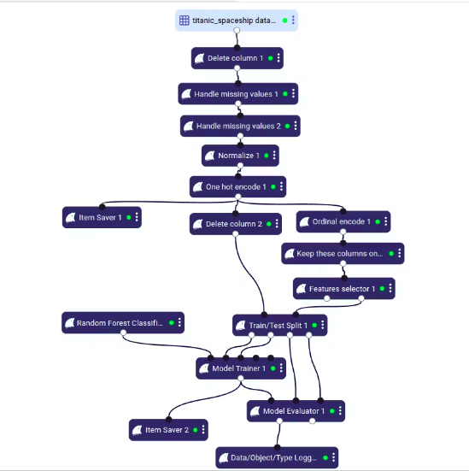
Proposed System
The proposed system is structured to rescue displaced passengers from the Spaceship Titanic's anomaly encounter. It starts with rigorous data recovery and cleansing, extracting fragmented data and preparing it for analysis. Feature engineering identifies crucial passenger and anomaly-related details. Anomaly detection algorithms pinpoint irregular patterns indicative of transported passengers. Supervised learning techniques predict the likely affected individuals. Integrating these models and deploying them for real-time use, the system aims to efficiently aid in identifying and retrieving those lost within the alternate dimension, leveraging machine learning for this critical rescue mission.

Slide 7
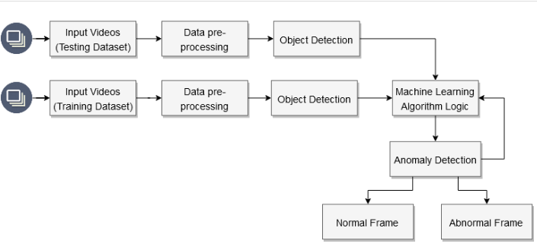
Block Diagram
1. Input Dataset: The input dataset comprises temporal records of various space weather parameters collected from satellite sensors and ground-based observatories. It includes data on solar wind speed, density, magnetic field variations, ionospheric conditions.
2.Data Pre-processing: This includes gathering information about passengers from various sources , handling missing values, outliers, and inconsistencies in the dataset creating new features or modify existing ones for better model prediction.
3.Object Detection: This consists of identifying features (attributes) in the dataset, analyzing and visualizing data to understand patterns and correlations, choosing the most relevant features for prediction and discard irrelevant ones.
4.Machine Learning Logic: This includes choosing suitable machine learning algorithms (e.g., logistic regression, decision trees, random forests) for prediction , training the selected models on the Titanic dataset using labeled data ,evaluating the model's performance using metrics like accuracy, precision, recall, or ROC curves , optimizing model performance by tuning hyperparameters.
5.Anomaly Detection: This comprises of identifying and handle outliers that might distort the models' predictions , detecting unusual or unexpected patterns in the dataset that might deviate from the norm ,implementing strategies to mitigate the impact of anomalies on model performance or analysis.

Slide 8
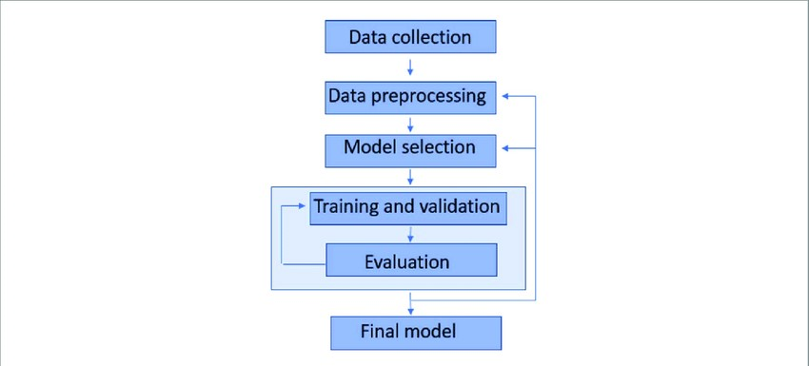
System Architecture
1.Data Collection and Storage: Sources like CSV files, databases, or APIs providing Titanic passenger information , storage solutions like databases (SQL or NoSQL) or data lakes to store and organize the dataset.
2. Data Processing and Pre-processing: Modules to clean, transform, and engineer features, handling missing values and outliers , identification of relevant features and removal of redundant ones.
3. Model Development and Training: Choosing appropriate machine learning algorithms (e.g., logistic regression, decision trees, neural networks),training models on historical Titanic data to predict survival.
4. Validation & Cross-Validation: Employing techniques like k-fold cross-validation to assess model generalization,evaluating models using validation metrics and selecting the best-performing model.
5.Model Deployment & Prediction:Selecting the best model based on validation performance,saving the trained model for future use,making predictions on the test dataset.

Slide 9
System Requirements
Hardware Requirements:
Software Requirements:
-CPU : Processor i5 or more
-RAM : 8GB
-Operating System
-Jupyter Notebook
-Anaconda Navig
-Python 3.8
Non Functional Requirements
Reliability:Handle unexpected or erroneous input data without crashing and maintain consistent performance.
Scalability:It should handle increased data volume or additional features without significant performance degradation.
Interpretability: Provide explanations or insights into the model's predictions, making it interpretable to stakeholders.
Platform Compatibility: Ensure compatibility with various operating systems or environments for deployment.

Slide 10
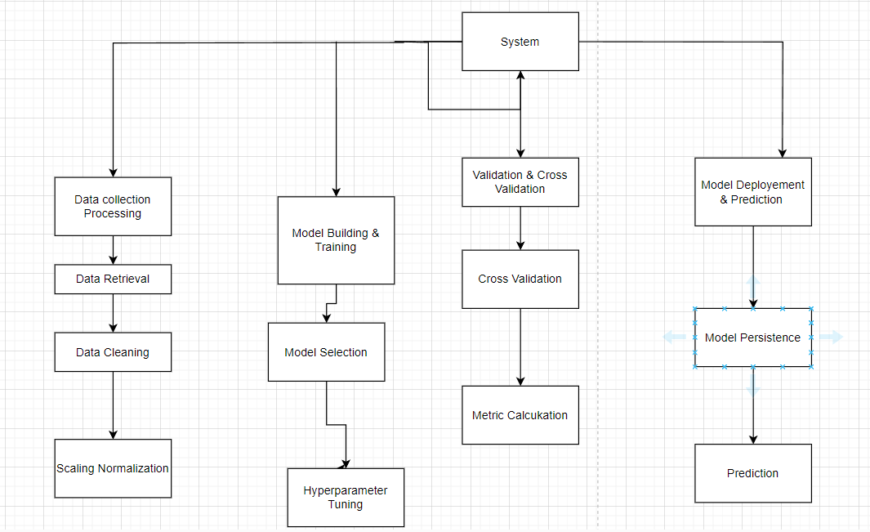
Module Design

Slide 11
Thank You

Slide 15
